Slide 1
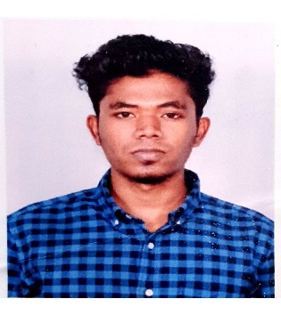




Devaraj Joel
Education and certificates
Synergy Institute of Technology, Bhubaneswar
Computer Science Engineering
2016-2020
Analyst/Software Engineer
Base Location: Mumbai
Skills
Email ID: deveraj.joel@capgemini.com
Java | Java Basics, OOPS, Generics, Collections, Arrays.
Framework | Spring Core, Spring Boot, Spring Data JPA, Spring Data REST.
Spring REST | REST Controller, Implementation of GET, POST, PUT, and DELETE. Controller and Repository layer
Database | PostgreSQL, MongoDB
Tools | Git, Eclipse, Spring Tool Suite, Intellij IDEA, Postman, Visual Studio Code, PgAdmin 4.
UI Tech | HTML 5, CSS 3, Bootstrap JavaScript, React
React | Components, Hooks, Event Handling, Redux, Reducer.
Mobile No: +91 8778369473
Grade: A4
Strengths
Achievement
Full Stack Developer trained on Java Hands on experience on
Shopping Cart
Case study at Shopping Cart System using Microservice along with Swagger, Junit, JWT. Responsive UI using HTML5, CSS3, Bootstrap, and React.
Git and GitHub.
MongoDB & PostgreSQL.
Core Java.
JPA with Hibernate.
Spring Framework.
HTML 5, CSS 3, Bootstrap, JavaScript
React.
Ready to learn new technologies and implement them for the future knowledge improvement
Arts and Crafts Academy
The main aim of our project on Art and Craft Academy is to manage the details of the customer and admin. It provides the customer to add/edit/view/delete the admission details and also provide the customer to review the academic performance.
Note Making System
This application is built to help customer to keep their note updated. User can save and delete the note. It is easy to use.
.

